Slide 1
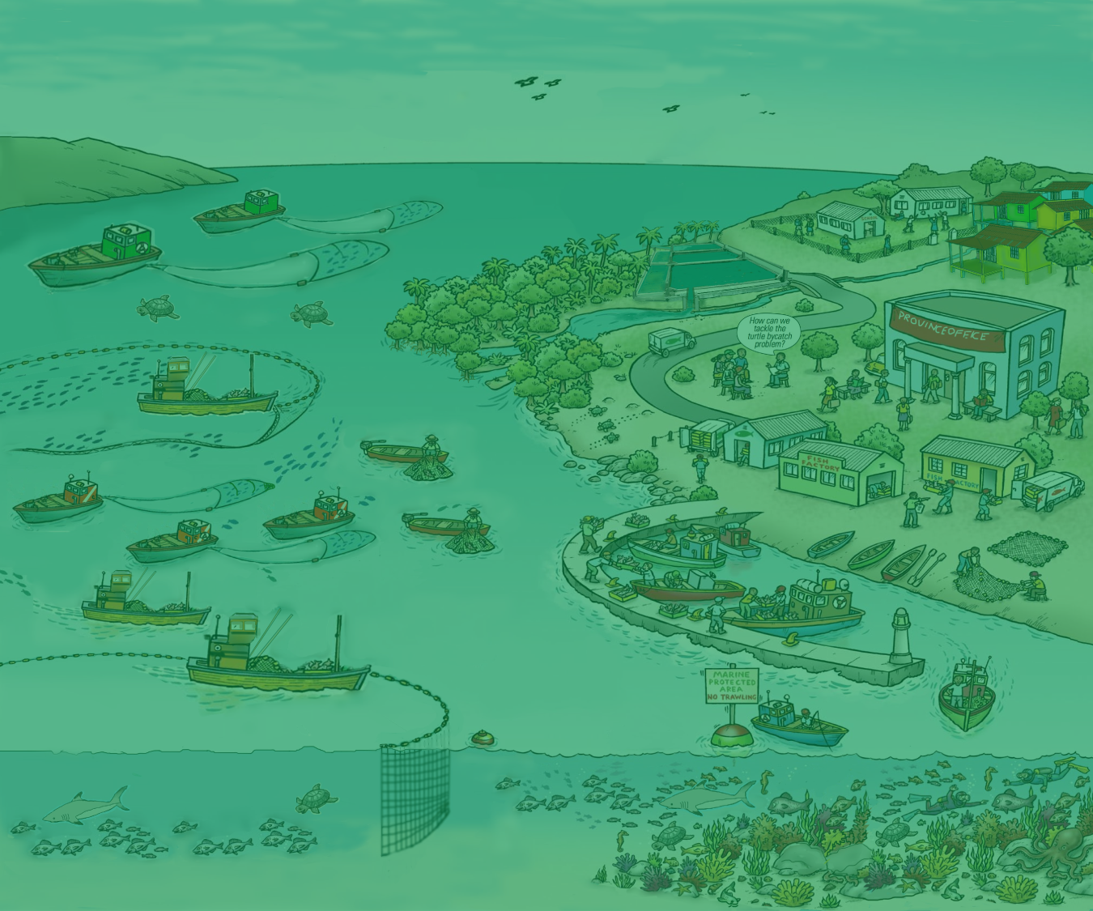
The what and why of an
Ecosystem Approach to
Fisheries Management
(EAFM)

Slide 2
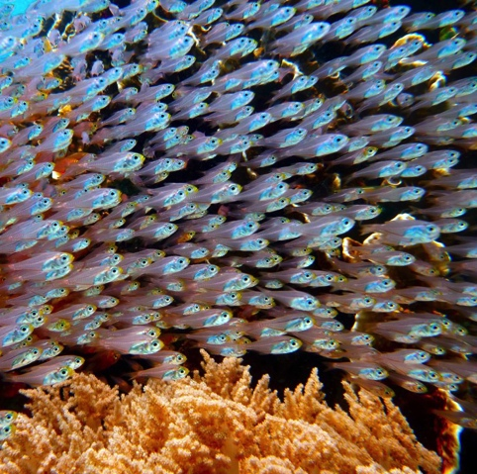
The future we want: our vision
Well-governed fisheries sector
Abundant fisheries resources
Healthy environment and habitats
Increased jobs, profits, and improved economy
Improved human health and prosperity
A legacy for you, your children, and future generations
Notes:
The vision.
These are examples of Key words and phrases that can be used to develop a vision statement. Based on these key words a vision statement could be:
“A well-governed fishery sector that promotes a healthy ecosystem and sustainable use of the marine resources for the benefit of the key stakeholders.

Slide 3
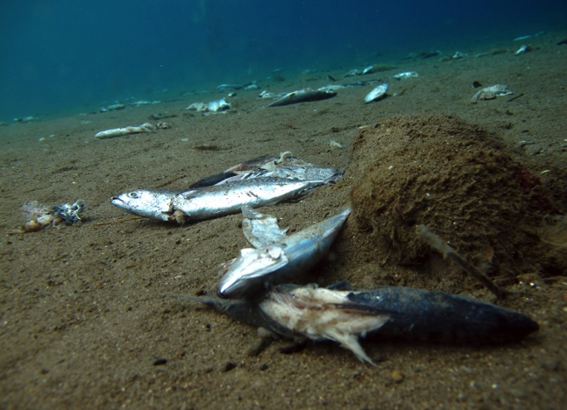
Threats and issues
Fisheries face many threats and issues that constrain us from achieving this vision
In the past, fisheries management tended to ignore the fact that many issues are interlinked
There is a need to holistically address all the issues impacting and/or impacted by the fisheries sector
One such holistic approach is the ecosystem approach
Notes:
Fisheries face many threats and issues and fisheries and the aquatic environment are severely degraded in many parts of the World, especially in Asia.
Fisheries management in the past has focused on mainly on fish and fishing and tended to ignore the fact that many issues are interlinked [e.g. overfishing can lead to decreased profits that results in people resorting to illegal, unreported and unregulated (IUU) fishing just to make a living] and tended to ignore the fact that many issues
There is a need to holistically address all the issues impacting and/or impacted by the fisheries sector.
One such holistic approach is the ecosystem approach
People are central to finding solutions. We manage people and their actions, not ecosystems.

Slide 4
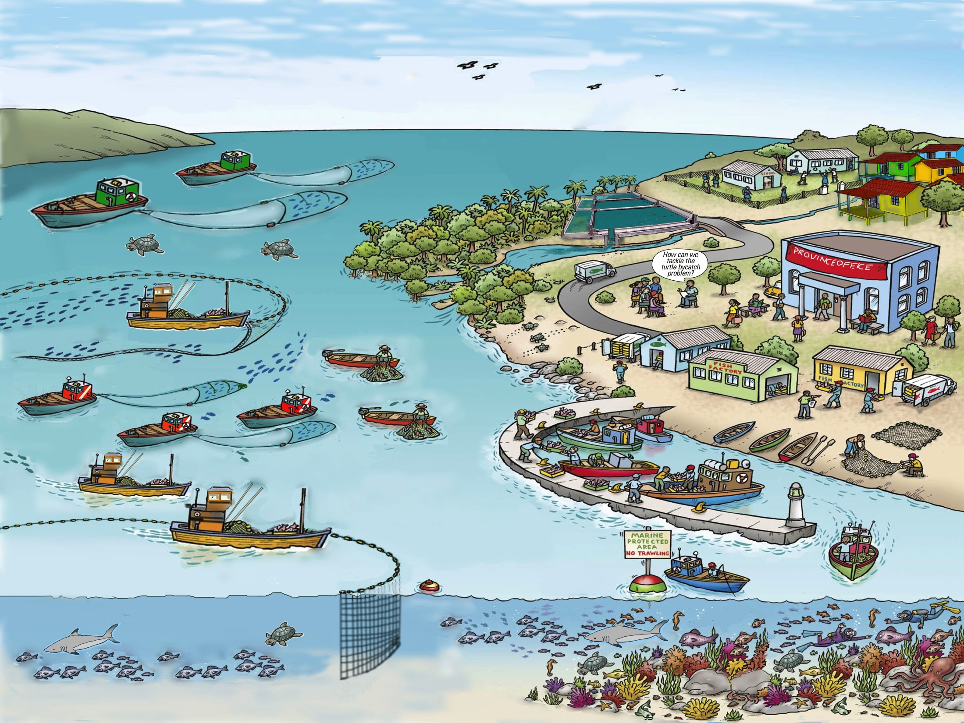
What is an ecosystem?
Image adapted from FAO EAF Nansen Project
Notes:
Firstly, before we talk about the ecosystem approach, what is an ecosystem? For a biologist, an ecosystem is pictured as a pyramid with several trophic levels ranging from primary producers to top carnivores.
However, when we talk about the ecosystem approach, as well the plants and animals in biologist’s picture, there are habitats such as mangroves and coral reefs, both small-scale and large-scale fishing, fish landing sites and processors, as well as other uses of the resources (aquaculture, scuba diving), and endangered and threatened species (turtles). In a prominent position of the ecosystem is the Fisheries Office and its staff.

Slide 5
What is the Ecosystem Approach?
The ecosystem approach is “a strategy for the integrated management of land, water and living resources that promotes conservation and sustainable use in an equitable way.”
--Convention on Biodiversity (CBD 2000)
Conservation + sustainable use + equitable way
= sustainable development
“Development that meets the needs of the present generation without compromising the ability of future generations to meet their needs”
Notes:
The concept of the ecosystem approach was formalized by the Convention on Biodiversity, which defined EA in 2000 as “It is a strategy for the integrated management of land, water and living resources that promotes conservation and sustainable use in an equitable way”.
It can be applied to any natural resource management situation, not just fisheries.
It is wotrh noting that the words conservation, sustainable use and equitable way are just another way of saying sustainable development . Sustainable development is “development that meets the needs of the present generation without compromising the ability of future generations to meet their needs”.

Slide 6
Sustainable development of fisheries
GOOD GOVERNANCE
ECOLOGICAL WELL-BEING
HUMAN WELL-BEING
FOR FUTURE GENERATIONS
EAFM is the ecosystem approach (EA)
applied to fisheries management (FM)
EA + FM = EAFM
Notes:
Sustainable development can be thought of as a process that strives to balance human well-being (e.g. employment, profit and sustainable livelihoods) with ecological well-being (e.g. healthy fish resources and healthy environment) so that development achieved in one generation does not impact on development for future generations – our sons and daughters.
Sustainable development has 3 dimensions –ECOLOGICAL (sometimes broken down into fisheries and the environment, HUMAN and GOVERNANCE dimensions. Good governance assures that the benefits are also there for future generations.
EAFM is simply the application of the ecosystem approach (EA) to fisheries management (FM) EA + FM = EAFM
Thus we can see that EA is a holistic, integrated and participatory management approach that considers the major components in an ecosystem, and the social and economic benefits that can be derived from the system both now and for the future

Slide 7
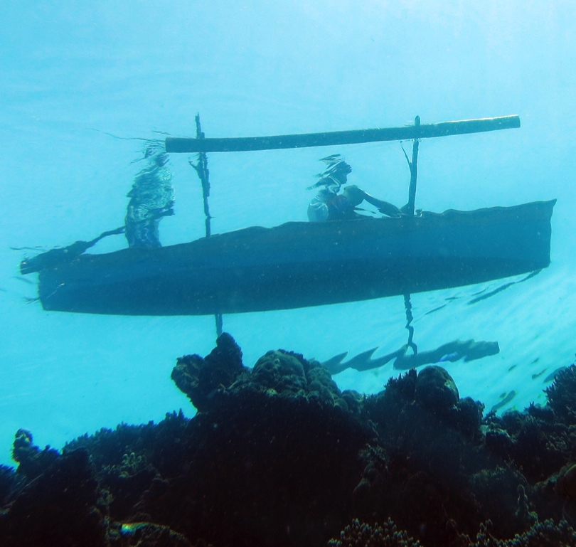
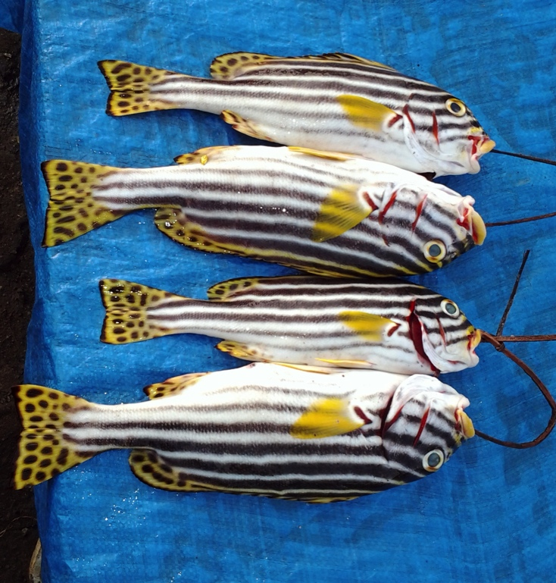
EAFM aims to maximize ecosystem benefits, resulting in increased food security & reduced poverty
Fish for food
Income
Employment
Livelihoods
Trade
Coastal protection
Notes:
EAFM aims to maximise ecosystem benefits that results in increased food security and reduced poverty. Theses ecosystem benefits include fish for food, fish for income, fish for employment, and fish for livelihoods, that all result directly in increased food security and reduced poverty. Further, increased foreign exchange and trade from fish and fishery products can increase reduce poverty, providing that the increased foreign revenue trickle down to the poorer people.
Through EAFM, other ecosystem benefits, such as coastal protection are also enhanced.

Slide 8
EAFM builds on what is in place
Builds on/improves existing management
Strengthens agencies through better planning and cooperation
Builds on and integrates co-management and other participatory approaches
Uses the traditional and scientific knowledge that already exists
Improves human capacity in skills needed for sustainable management
Notes:
It is important to realise that EAFM is not really new – it builds on what is already in place in your country and fisheries. For example, You will already be doing some fishery management that will include co-management.
Also importantly, EAFM recognizes that human skills are just as important as technical and scientific knowledge.

Slide 9
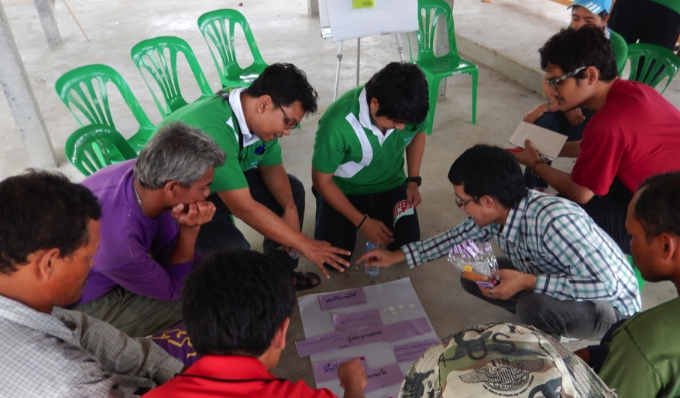
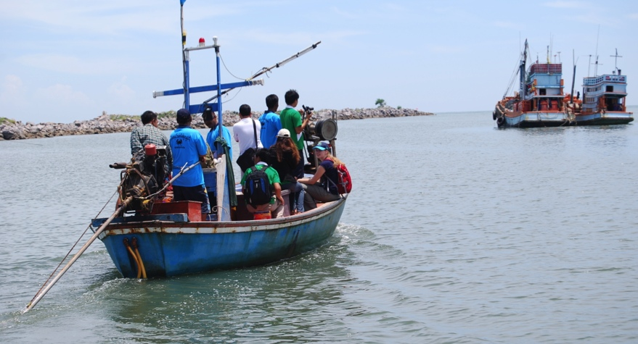
EAFM strengthens co-management
Encourages stakeholder engagement
Improves facilitation
Requires effective negotiation
Improves conflict resolution
Notes:
Through strengthening co-management with its focus on stakeholder engagement, facilitation, negotiation and conflict resolution, all important skills in finding solutions to the issues.

Slide 10
Key principles of EAFM
1. Good governance
2. Appropriate scale
3. Increased participation
4. Multiple objectives
5. Cooperation & coordination
6. Adaptive management
7. Precautionary approach
Notes:
Seven principles that distinguish EA from existing/conventional fisheries management;
Good governance: designing rules and regulations and ensuring compliance with these through improved transparency and accountability;
Appropriate scale: management takes into account spatial and temporal scales and delivers at the appropriate scale for the issue: political, geographic, multi-sectoral;
Increased participation: Stakeholders need to work together in management planning and implementation (co-management);
Multiple objectives: Takes account of the different objectives of different stakeholders and considers trade-offs;
Cooperation and coordination: Needed horizontally across sectors and agencies and vertically across levels of government;
Adaptive management: Learn through controlled trial and error; and
Precautionary approach: Don’t delay action because of a lack of information and be risk averse when there is uncertainty

Slide 11
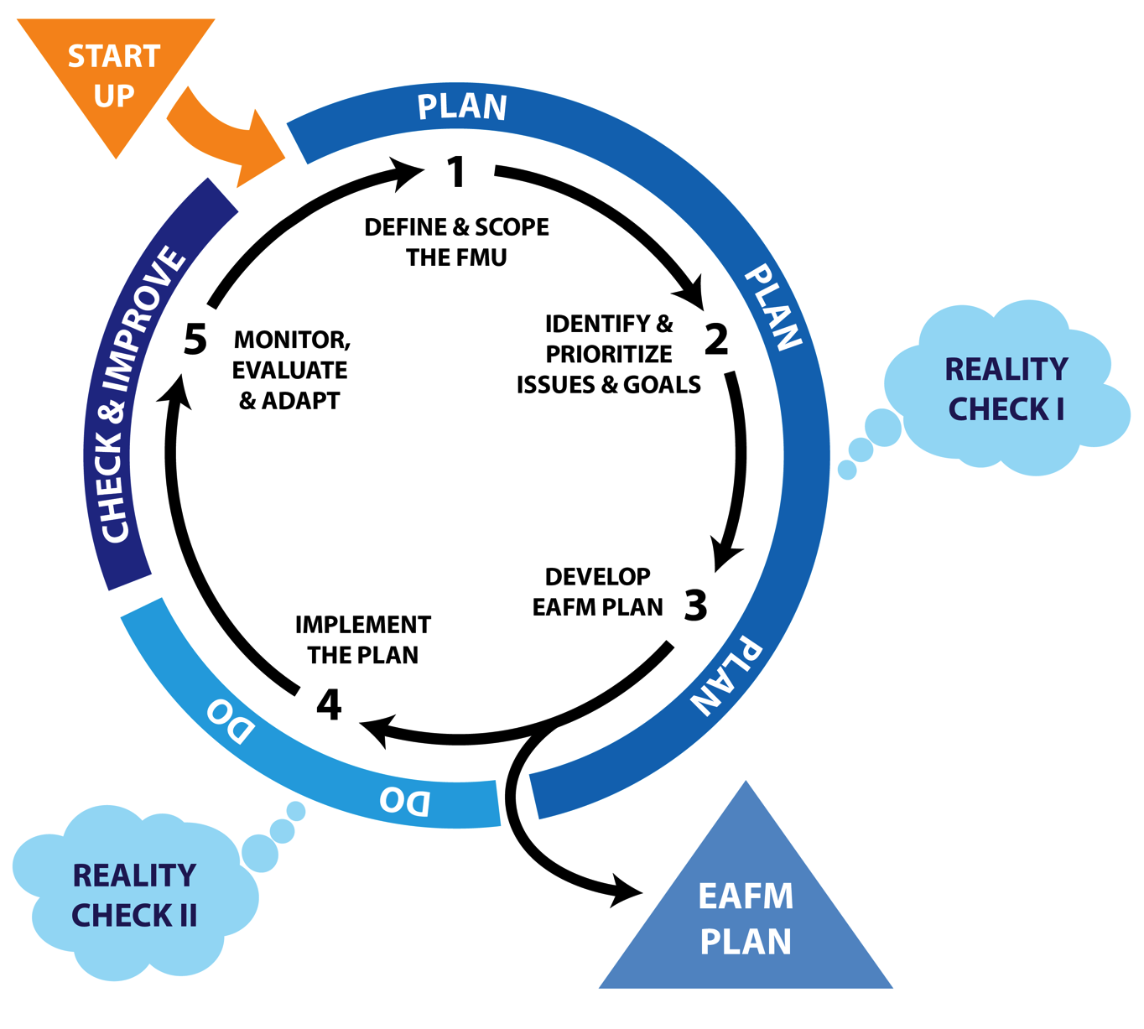
EAFM is based on
PLAN DO CHECK & IMPROVE
Notes:
The EAFM cycle is based on the generic management cycle of PLAN – DO – CHECK & IMPROVE.
There are three PLANING steps, one DOING step and one CHECKING & IMPROVING step – a total of 5 steps.
For the first time, the start up process is very important during which time an EAFM Team is formed and stakeholders identified,
An important output of the process is an EAFM Plan.

Slide 12
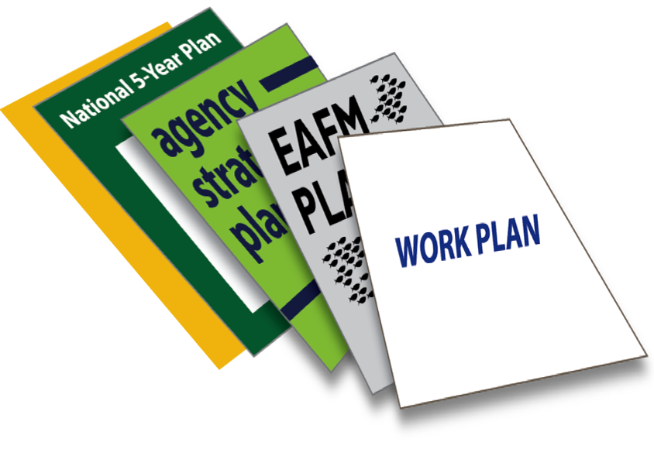
EAFM PLAN:
linking legislation & policy to action
Example
Sustainably manage fisheries
Legislation/policy
EAFM PLAN
Limit fishing effort in the trawl fishery
Control number of fishing boats/gears
Management actions
Notes:
EAFM encourages good planning, and implementing actions linked logically to these plans and higher level policies/legislation. It emphasises that having an EAFM plan will help link the high-level policy objectives, often derived from International Conventions, Treaties, and similar instruments, as well as national legislation and policies that already exist in most countries with actual management actions on the ground that will implement those policies.
Legislation and policies say what needs to be achieved. Plans (linked to rules and regulations) say how they will be achieved.
One example is given – one fisheries
Fisheries legislation (e.g. Fisheries Act ) and policies (e.g. 5-year National social and economic development plan) will often have an aim of “Sustainably management fisheries”. However, unless supported by practical plans that sets out management actions these aim will never be achieved. The plan specifies the need to limit the fishing effort in the trawl fishery and the management action of controlling the number of boats and fishing gear
Another ecological example:
Environmental legislation (e.g. Environment Protection Act) and policies (e.g. Marine conservation policy) often state have an aim of a “Healthy Environment”. To achieve this aim in a fisheries context, a plan is required that specifies the need to protect the fish habitat and a management action of closing a selected area through a marine protected area (MPA)

Slide 13
EAFM complements other approaches
Co-management
Conventional fisheries management
EAFM
Integrated coastal zone management
Marine spatial planning
EA/EBM
13
Notes:
EAFM complements other approaches that you may know:
The all-encompassing circle is EA/EBM. Within this we have:
co-management
integrated coastal zone management (ICM or ICZM),
Marine spatial planning (MPS), and
Conventional fisheries management.
EAFM incorporates all of conventional fisheries management and overlaps with co-management, ICZM and MSP. For EAFM, MSP (and MPAs) can be thought of as a management tool.
Let participants explain why they think that circles should be moved to reflect the situation in their particular country.

Slide 14
What’s in it for you and your agency?
Helps link existing approaches through a logical and comprehensive framework
Focuses on the real issues and their causes
Increases trade opportunities and demand for fisheries products
Reduces conflicts and political tensions
Helps staff become more effective in natural resource management
Helps leverage funding and leads to better reallocation of existing funds
Results in sharing of responsibilities and human resources with other agencies
You and your agency WILL make a difference
for the fisheries, the people, and the environment…
Notes:
IN SUMMARY
EAFM is a framework to help you bring different management strategies/approaches together in a clear, logical and structured approach with relevance to fisheries (e.g. co-management, coastal zone management, MPAs etc)
EAFM provides a better planning and management framework and focuses on the REAL issues and what is causing them across the ecological, social and economic dimensions of sustainable development
EAFM will help to reduce conflict, resulting in fewer protests and greater support from your people
EAFM will improve the ability of your staff to manage natural resources
EAFM can help you get more funding by
a) having well-designed plans that will influence your national budget allocation and donor funding support;
b) sharing finances and resources with other partners;
c) providing support for reallocation of funds for more effective/efficient use
Other selling points (depending on the audience) are:
EAFM helps stakeholders increase their sense of stewardship of the resources that they are dependent on and they are more likely to comply with management rules and regulations
EAFM strengthens co-management and can help coordinate staff and resources of different agencies
EAFM will result in better management of the resources in your country that will increase demand for your fish and secure a larger market share
EAFM is adaptable and can be applied to other systems such as inland fisheries
EAFM helps to improve your image as a leader and establish a legacy for introducing a fully integrated approach to fishery governance;

Slide 15
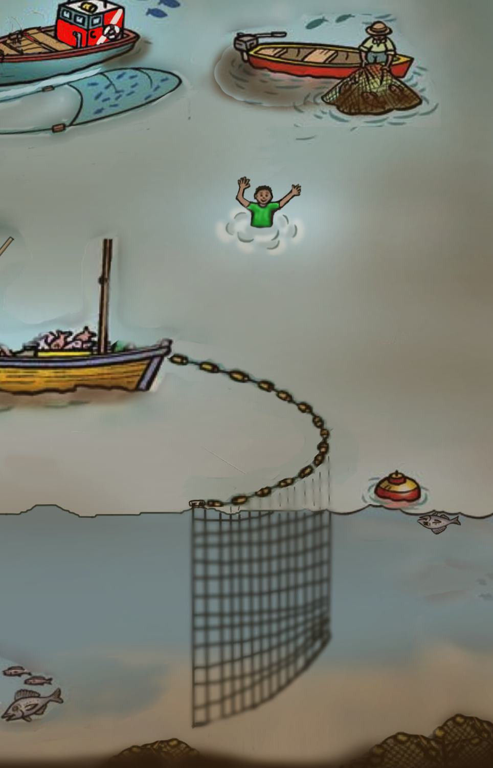
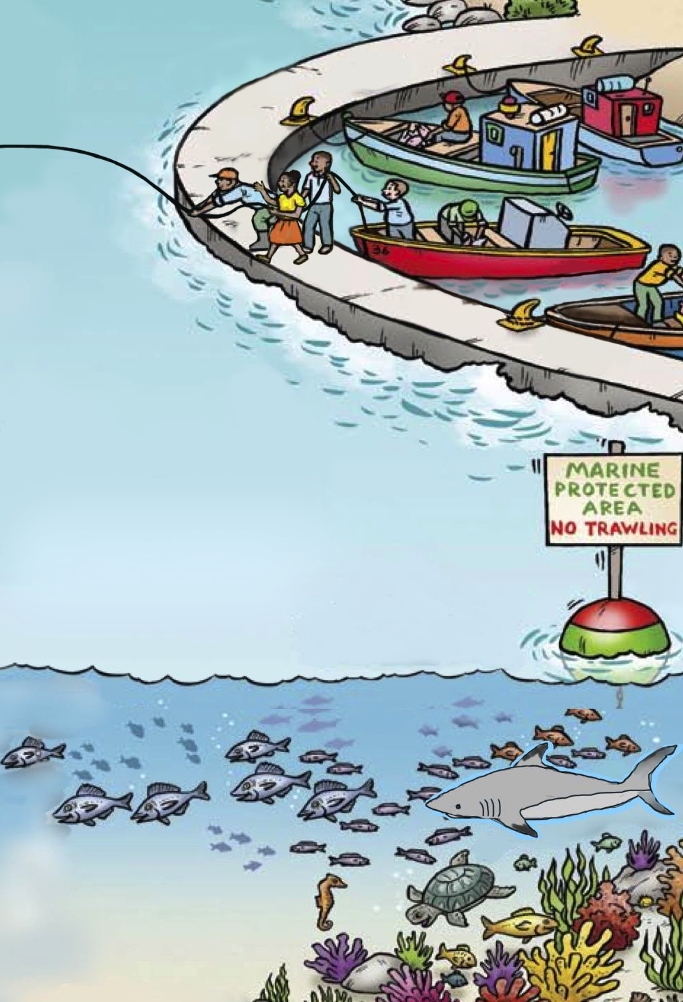
Help is at hand!
Images adapted from FAO EAF Nansen Project

Slide 16
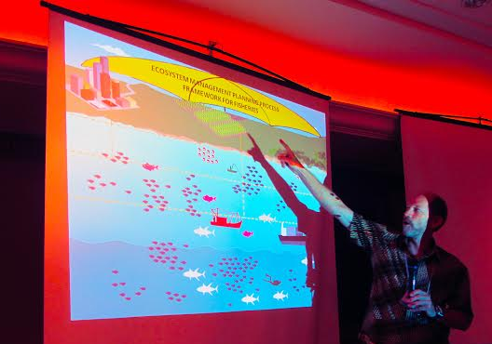
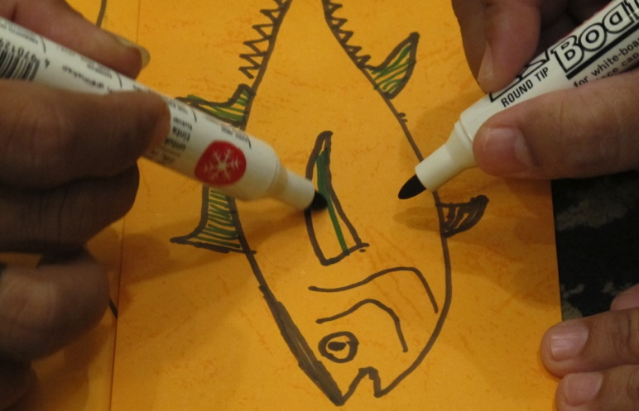
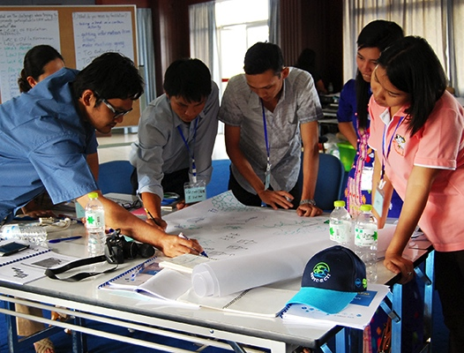
Essential EAFM training package
EAFM LEAD (leaders, executives, and decision makers) “toolkit”
Regional trainers and training institutions
www.eafmlearn.org
Notes:
The E-EAFM course is a week-long comprehensive, hands on course to help staff involved in fisheries and environmental management implement EAFM and manage fisheries more sustainably.
The LEAD “tool box” has useful tools ranging from a 1 minute script, brochures and short videos to a 1-day High Level Consultation that will help raise awareness and gain support of other leaders
Throughout various regions of the World, especially in Southeast and South Asia there are a large number of trainers qualified to assist in E-EAFM and LEAD and a number of training institutions have been established.
Find out more from EAFMLEARN.ORG

